Slide 1
Ionospheric Convection and Field-Aligned Currents During Strong Magnetospheric Driving:
A SuperDARN/AMPERE Case Study
L. B. N. Clausen⁽¹⁾, J. B. H. Baker⁽¹⁾,
J. M. Ruohoniemi⁽¹⁾, B. J. Anderson⁽²⁾
Space@VT, Virginia Tech, Blacksburg, USA
Johns Hopkins University Applied Physics Laboratory, Laurel, USA
SuperDARN Workshop 2011

Slide 2
Section Name
Subsection name
Slide Title
Introduction
Name (Space@VT)
Short Presentation Title
Meeting, Date

Slide 3
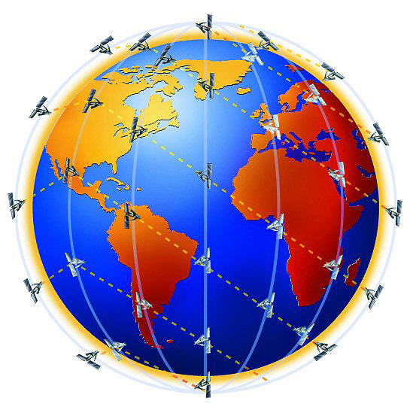
Introduction
AMPERE Overview
The Active Magnetosphere and Planetary Electrodynamics Response Experiment (AMPERE) is based on the constellation of Iridium® Communications satellites.
The Iridium® constellation consists of >66 satellites in six 780-km altitude, circular polar orbit planes.
Each satellite carries a magnetometer!
Lasse Clausen (Space@VT)
SuperDARN/AMPERE study
SD Workshop, June 2011

Slide 4
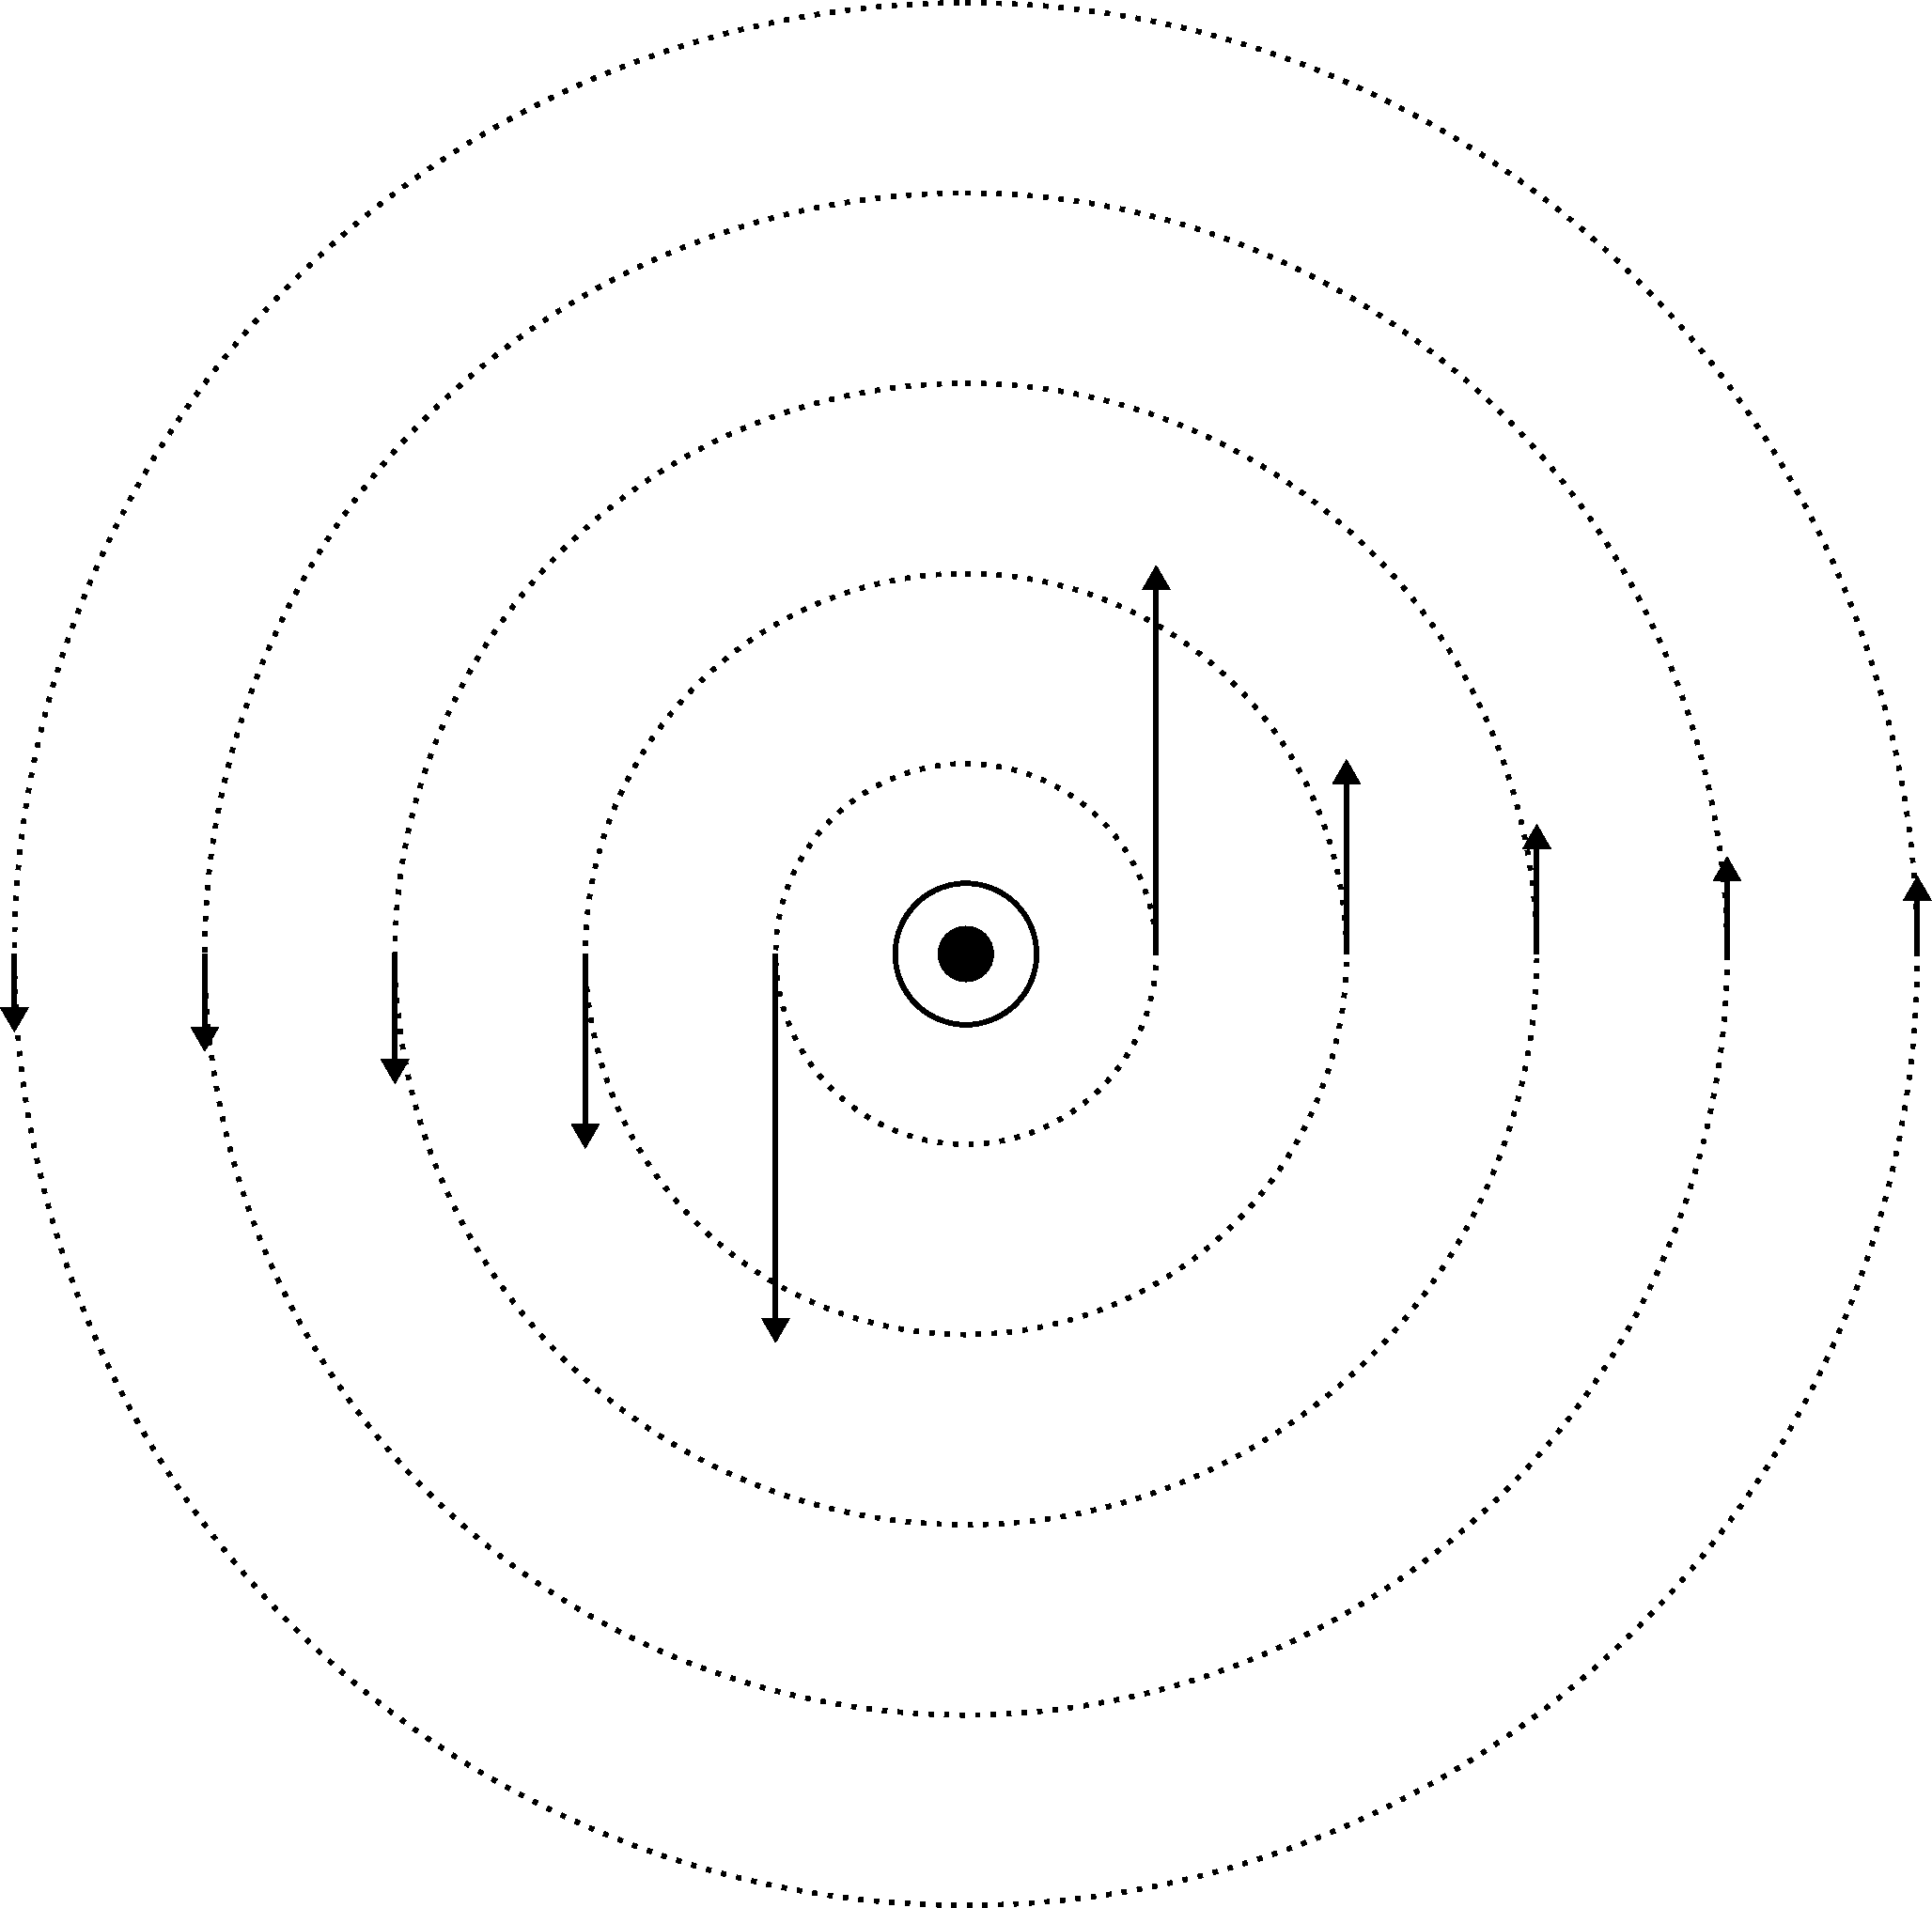
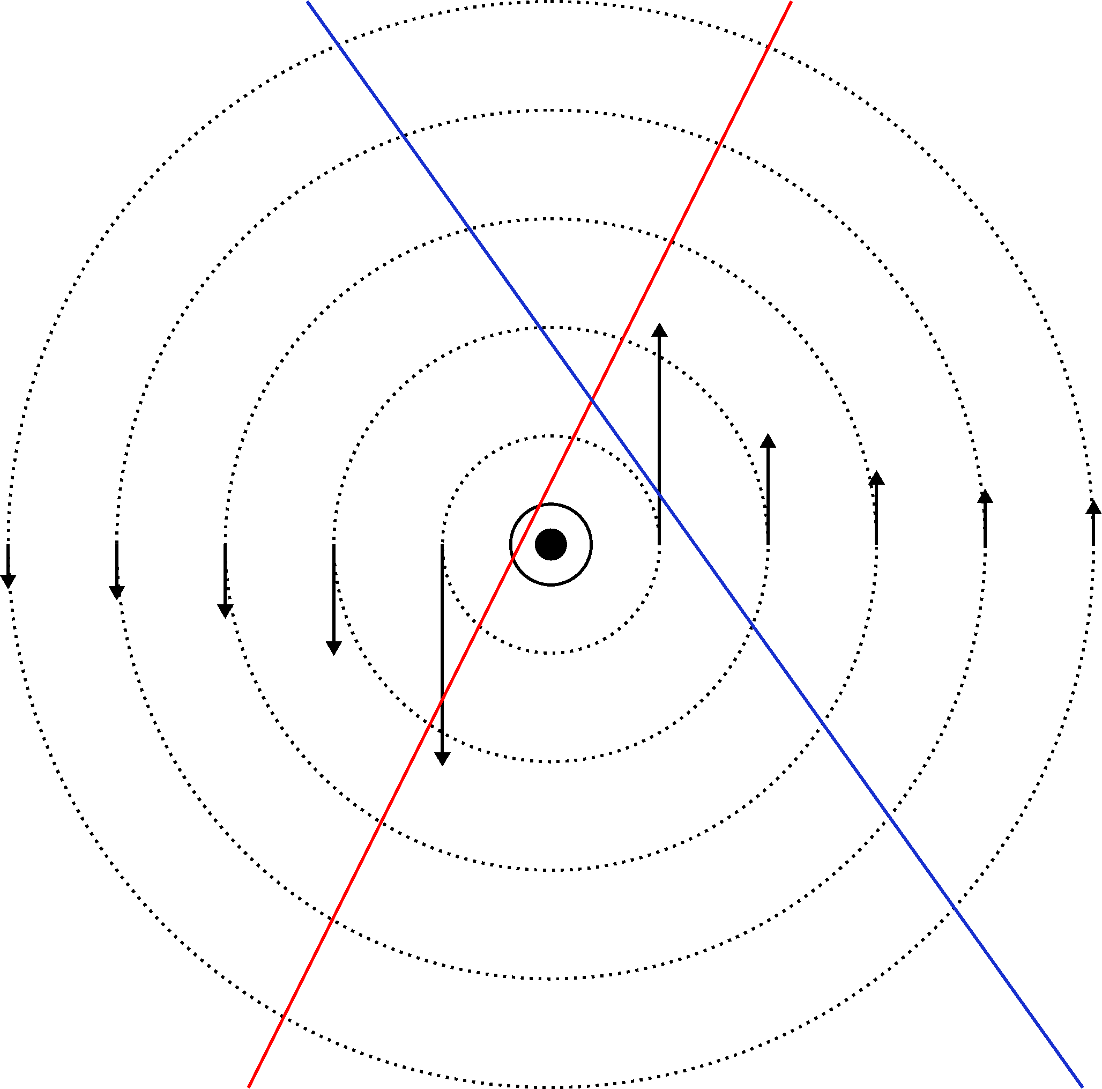
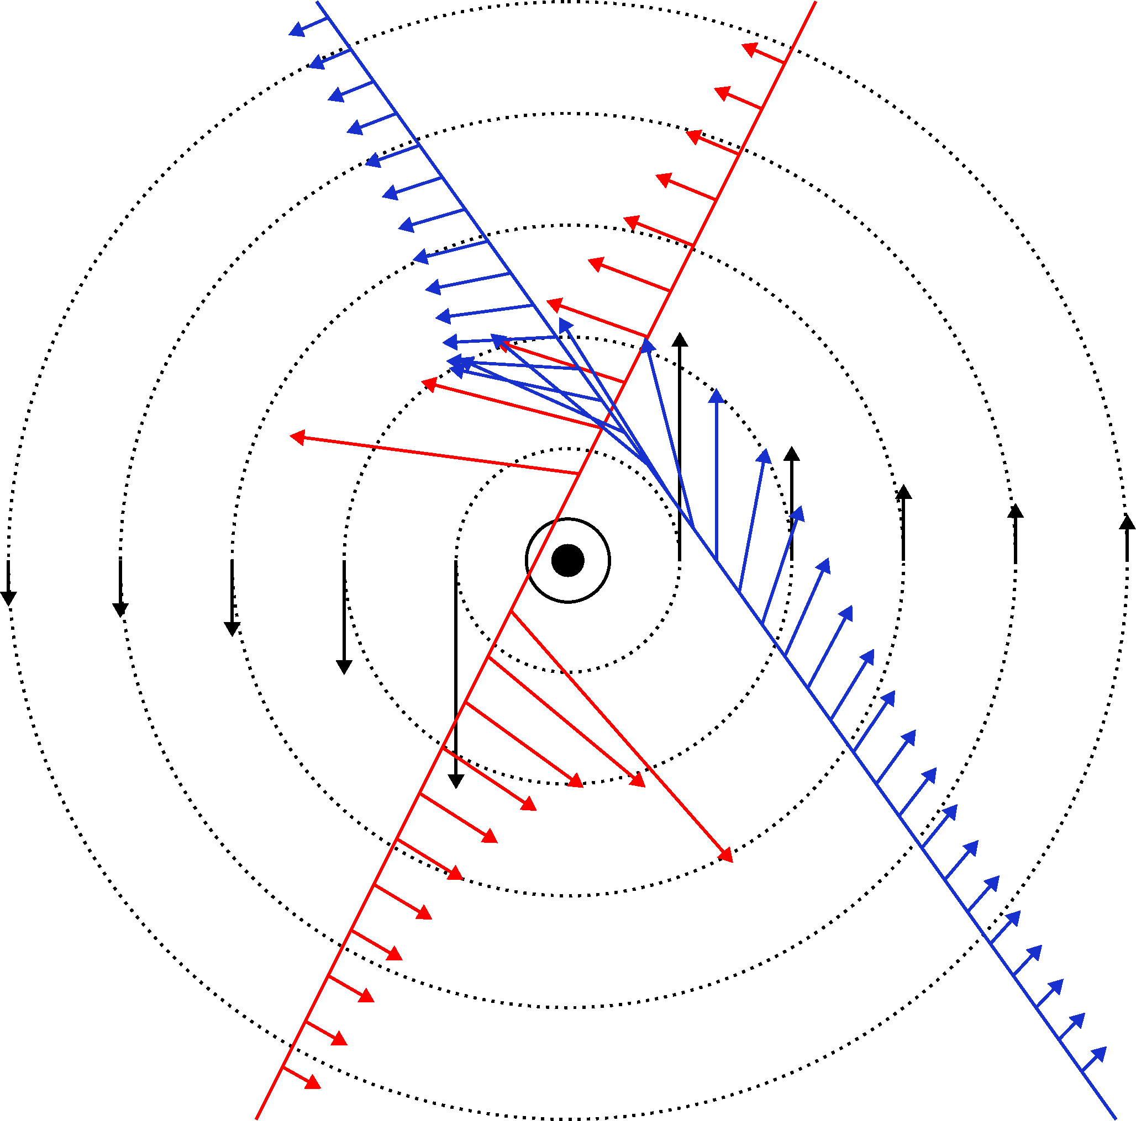
Introduction
AMPERE Overview
Consider line current perpendicular to satellite motion
Current creates magnetic field
Satellite measures magnetic perturbation.
Reconstruct current from magnetic perturbation:
curl B = μ₀ j
Lasse Clausen (Space@VT)
SuperDARN/AMPERE study
SD Workshop, June 2011

Slide 5
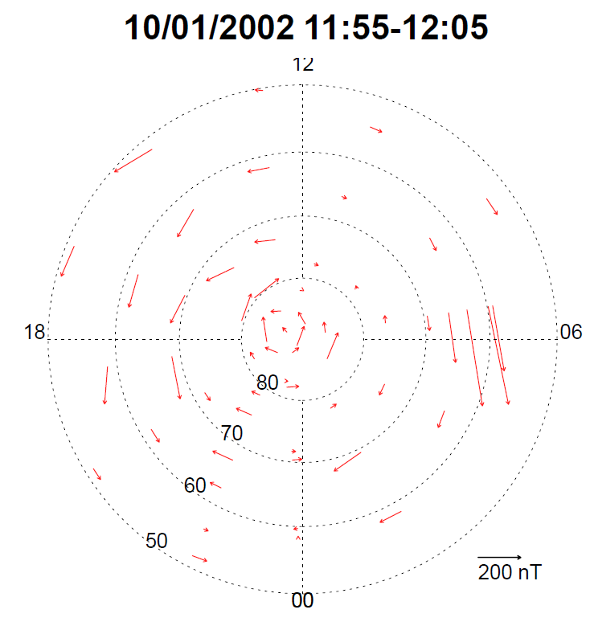
Introduction
AMPERE Overview
But Iridium® magnetometers are engineering magnetometers, used for attitude control:
Low resolution:
30 nT
Low time cadence: 200 s/sample
Anderson et al., 2010
Lasse Clausen (Space@VT)
SuperDARN/AMPERE study
SD Workshop, June 2011

Slide 6
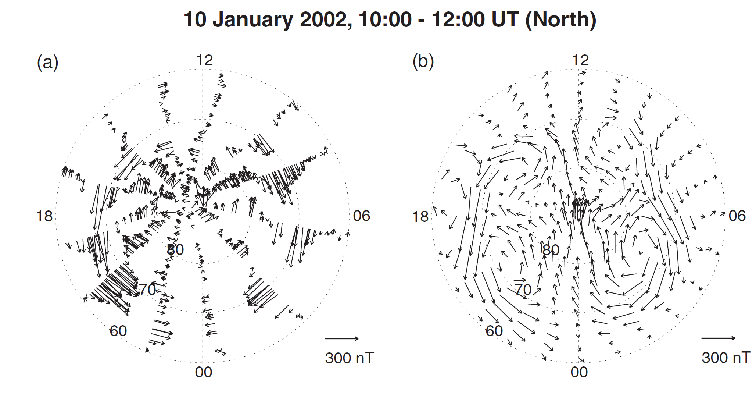
Introduction
AMPERE Overview
Korth et al., 2008
Lasse Clausen (Space@VT)
SuperDARN/AMPERE study
SD Workshop, June 2011

Slide 7
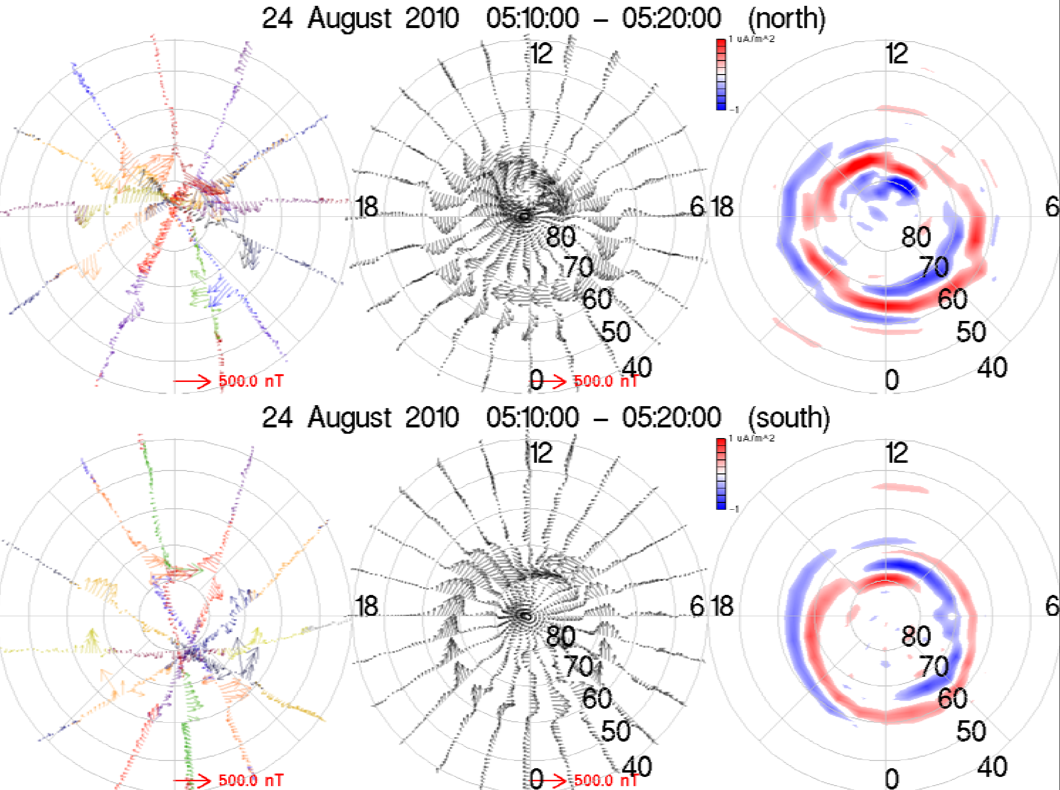
Introduction
AMPERE Overview
Ampere provides high-time resolution measurements of the magnetic perturbation
20 s/sample
2 s/sample
Anderson et al., 2010
Lasse Clausen (Space@VT)
SuperDARN/AMPERE study
SD Workshop, June 2011

Slide 8
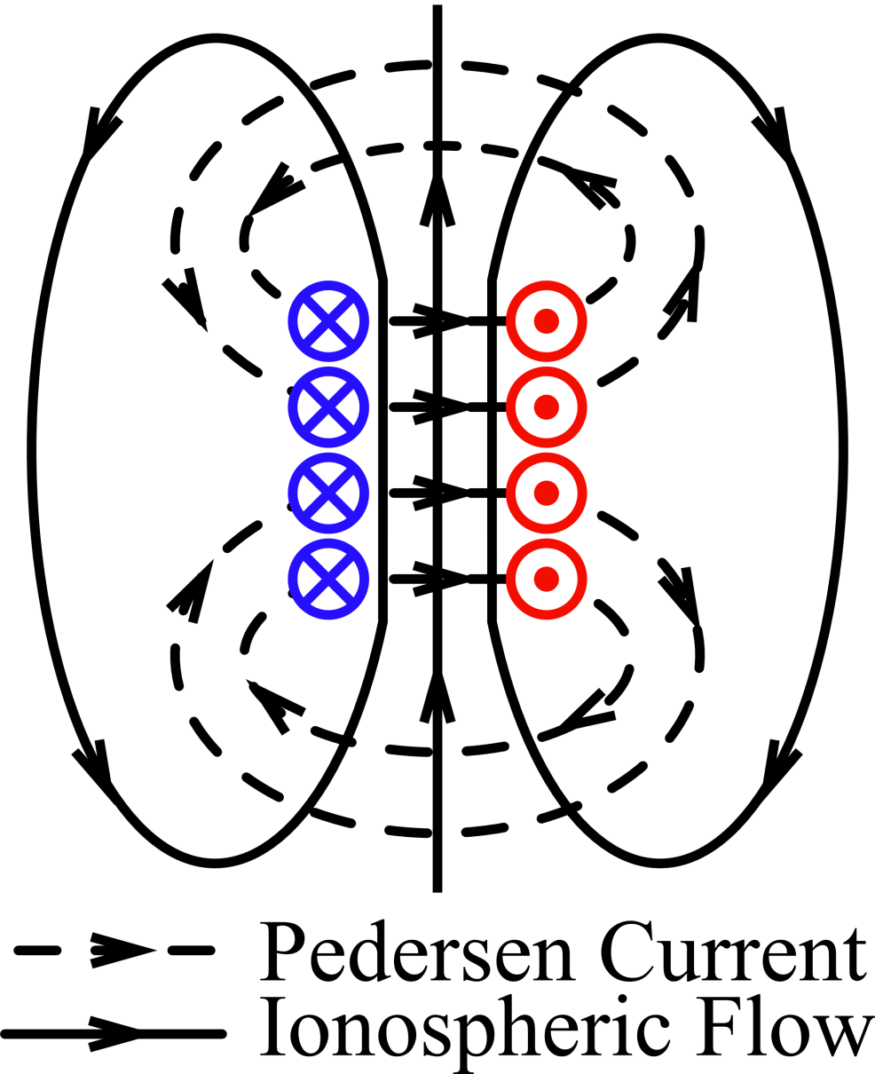
Introduction
FACs
Field-aligned currents are a crucial element in magnetosphere-ionosphere coupling
All currents in the magnetosphere-ionosphere system are divergence free
Field-aligned currents close via Pedersen currents in the ionosphere
Lasse Clausen (Space@VT)
SuperDARN/AMPERE study
SD Workshop, June 2011

Slide 9
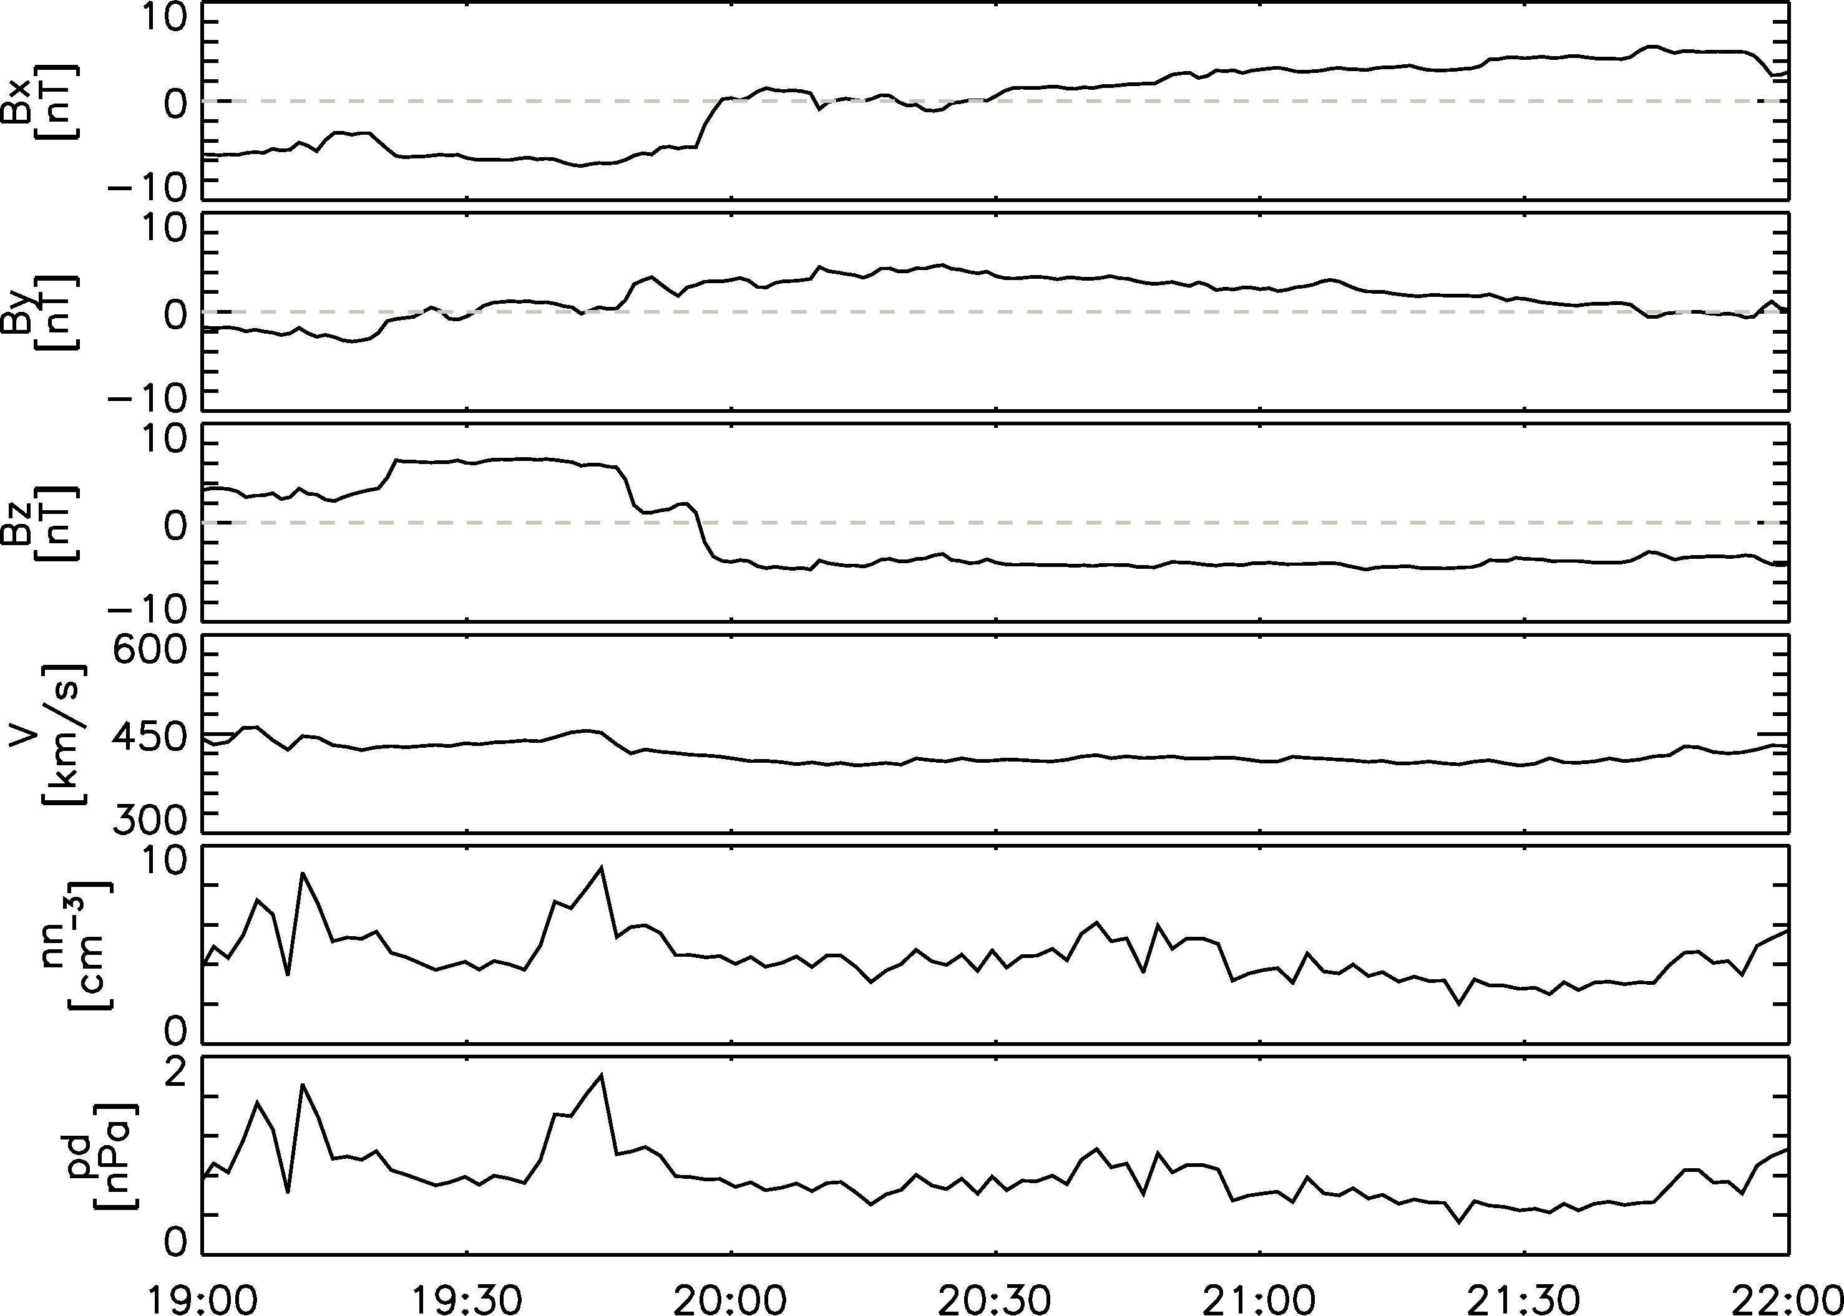
Observations
Solar Wind Conditions
Geotail was located 5 Re upstream of the bow shock
The data are lagged by 15 minutes
Northward IMF was followed by southward IMF
Lasse Clausen (Space@VT)
SuperDARN/AMPERE study
SD Workshop, June 2011

Slide 10
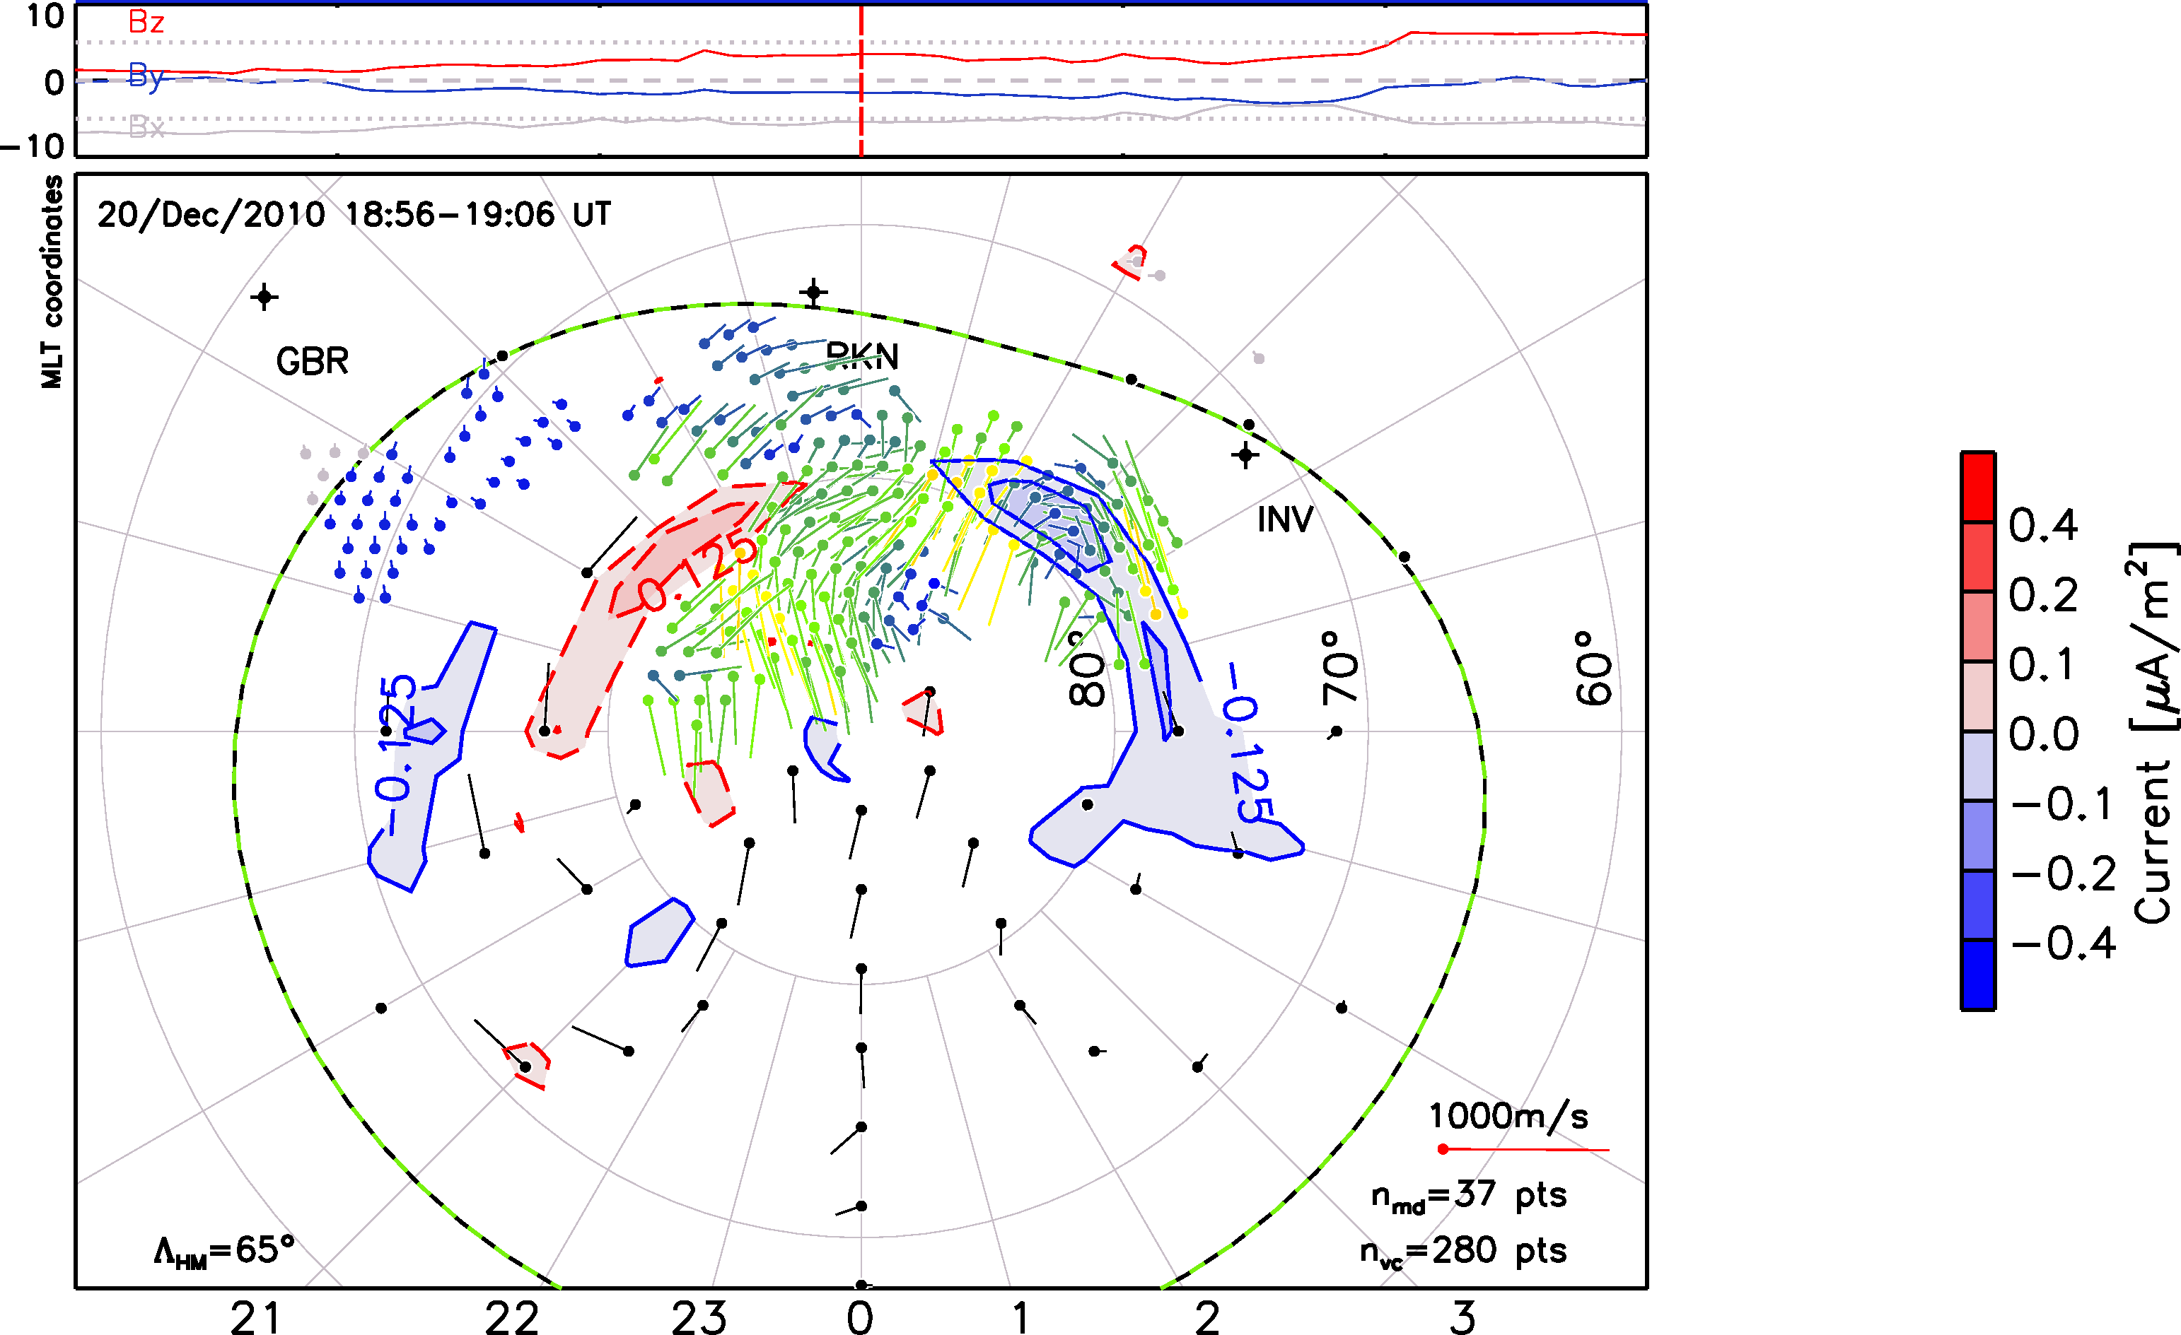
Observations
SuperDARN & AMPERE
Lasse Clausen (Space@VT)
SuperDARN/AMPERE study
SD Workshop, June 2011

Slide 11
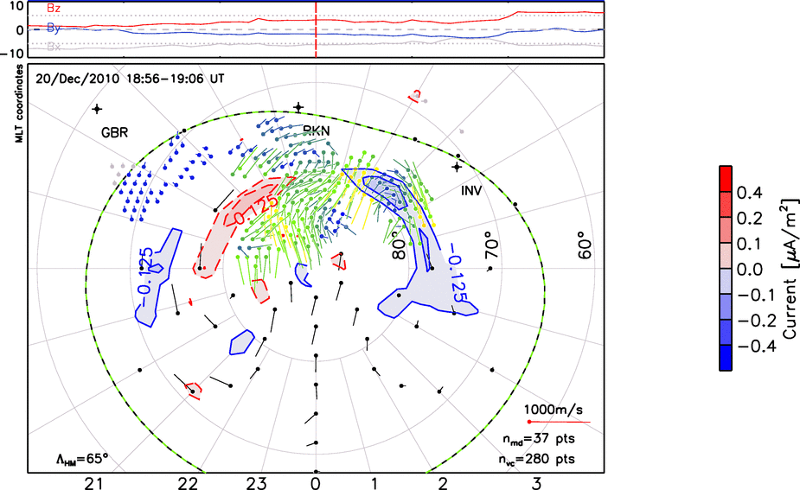
Observations
SuperDARN & AMPERE
Lasse Clausen (Space@VT)
SuperDARN/AMPERE study
SD Workshop, June 2011

Slide 12
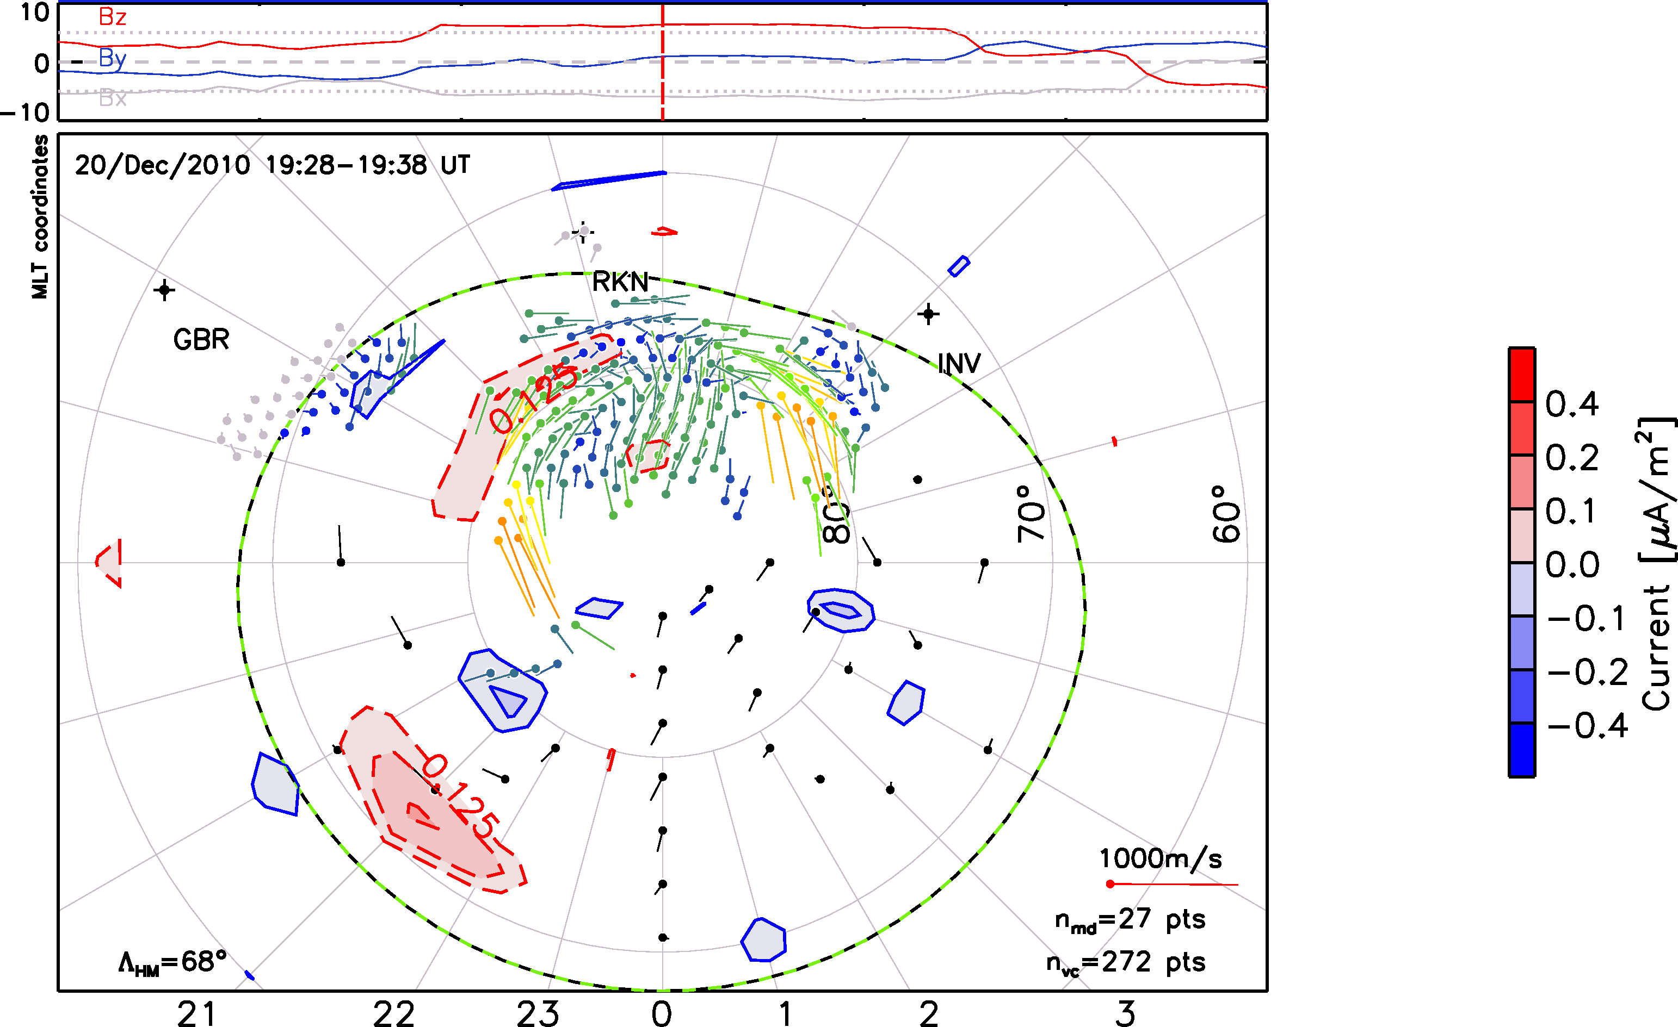
Observations
SuperDARN & AMPERE
Lasse Clausen (Space@VT)
SuperDARN/AMPERE study
SD Workshop, June 2011

Slide 13
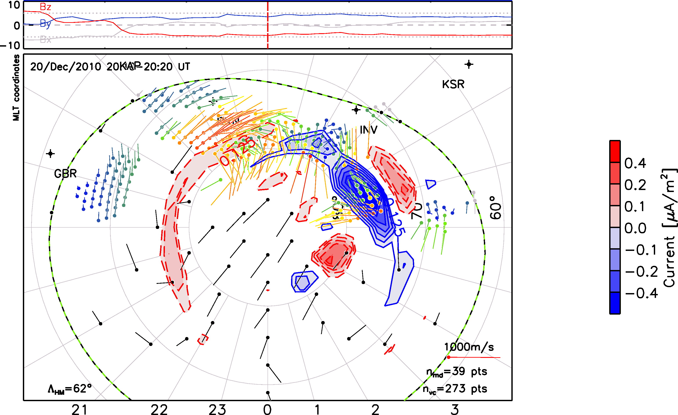
Observations
SuperDARN & AMPERE
Lasse Clausen (Space@VT)
SuperDARN/AMPERE study
SD Workshop, June 2011

Slide 14
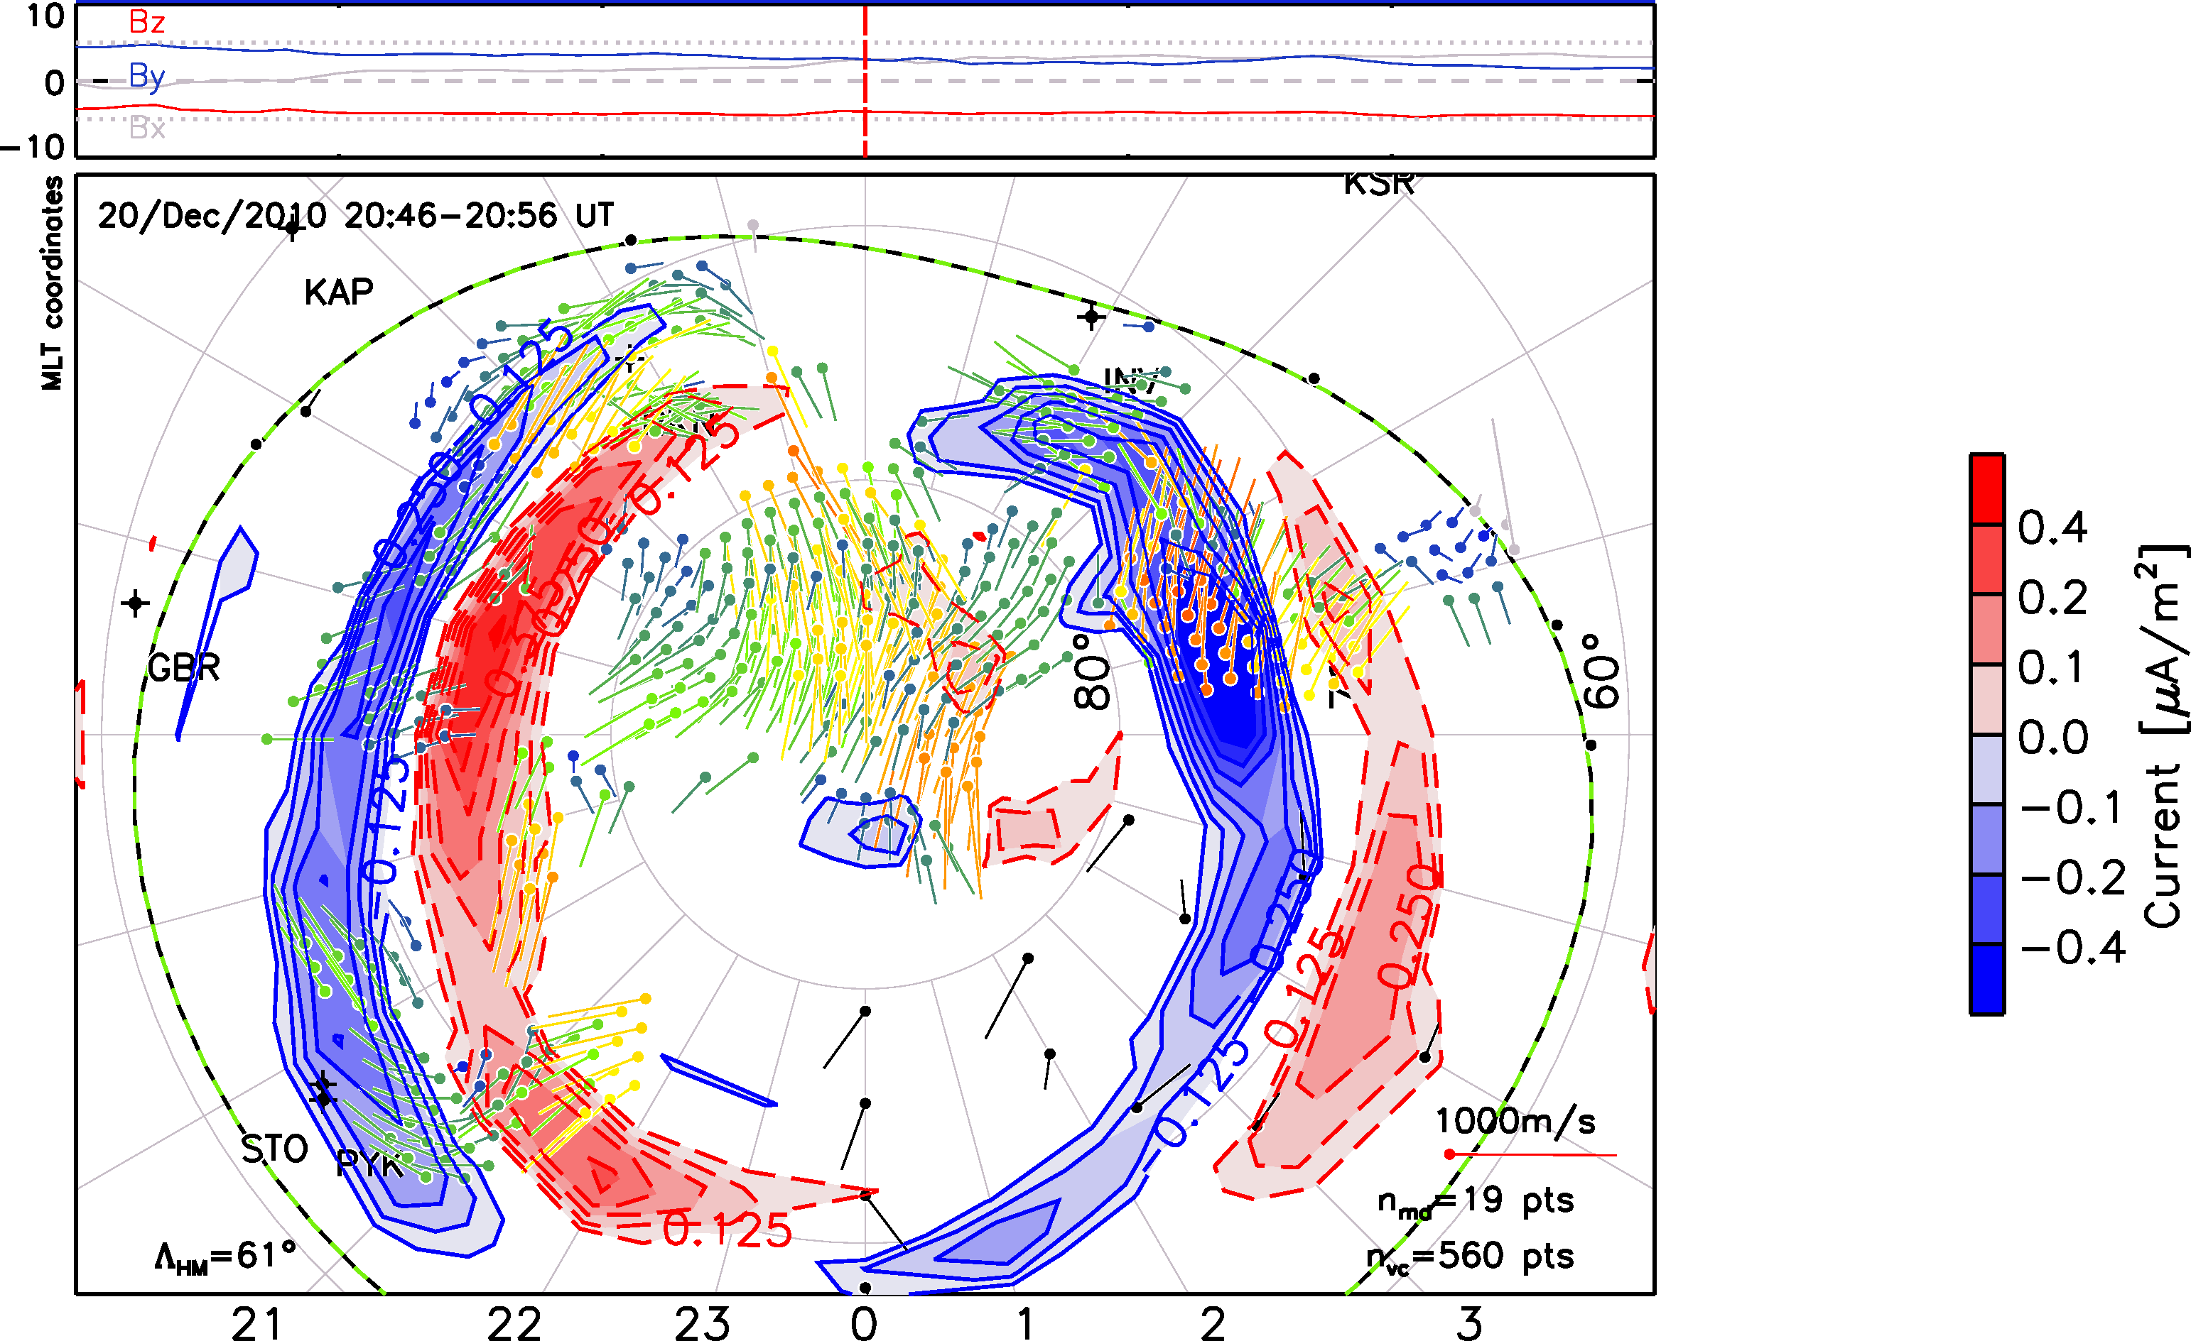
Observations
SuperDARN & AMPERE
Lasse Clausen (Space@VT)
SuperDARN/AMPERE study
SD Workshop, June 2011

Slide 15
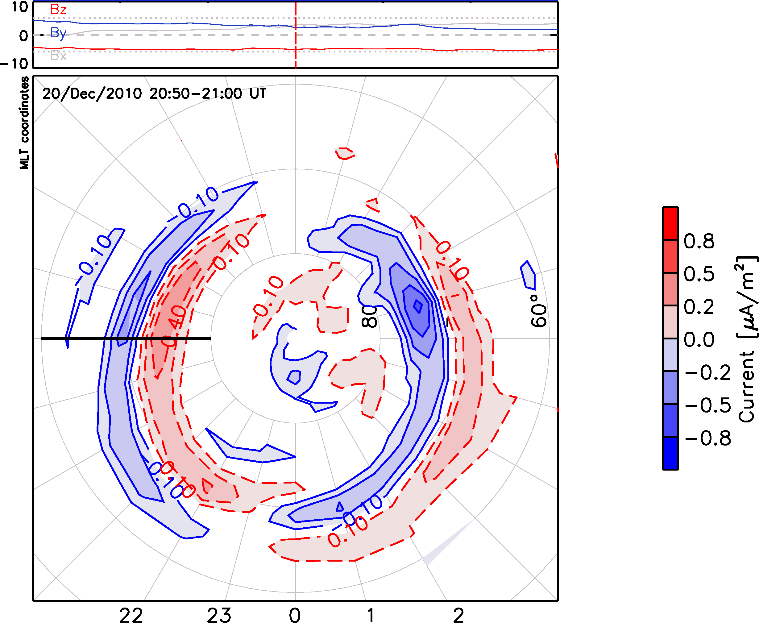
Observations
Locating FACs
Extract FAC intensity at each MLT
Fit a suitable function to each meridional profile
Combine locations from all meridional profiles to get a hemispheric FAC location
Lasse Clausen (Space@VT)
SuperDARN/AMPERE study
SD Workshop, June 2011

Slide 16
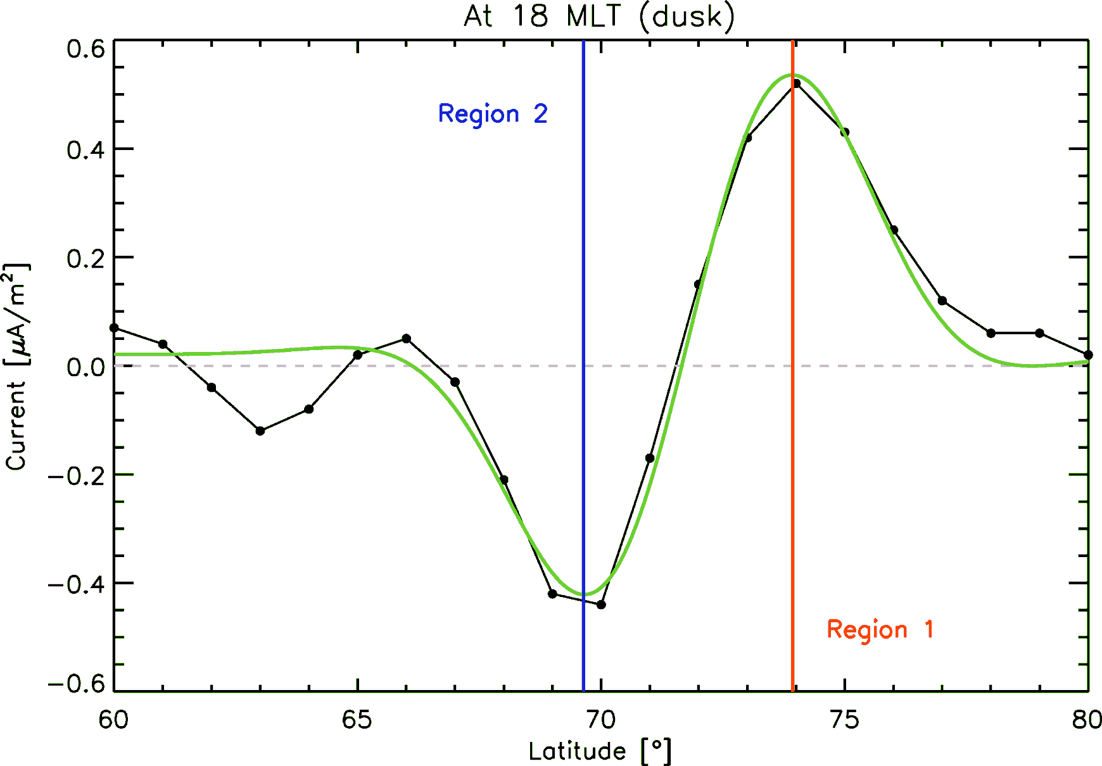
Observations
Locating FACs
Extract FAC intensity at each MLT
Fit a suitable function to each meridional profile
Combine locations from all meridional profiles to get a hemispheric FAC location
Lasse Clausen (Space@VT)
SuperDARN/AMPERE study
SD Workshop, June 2011

Slide 17
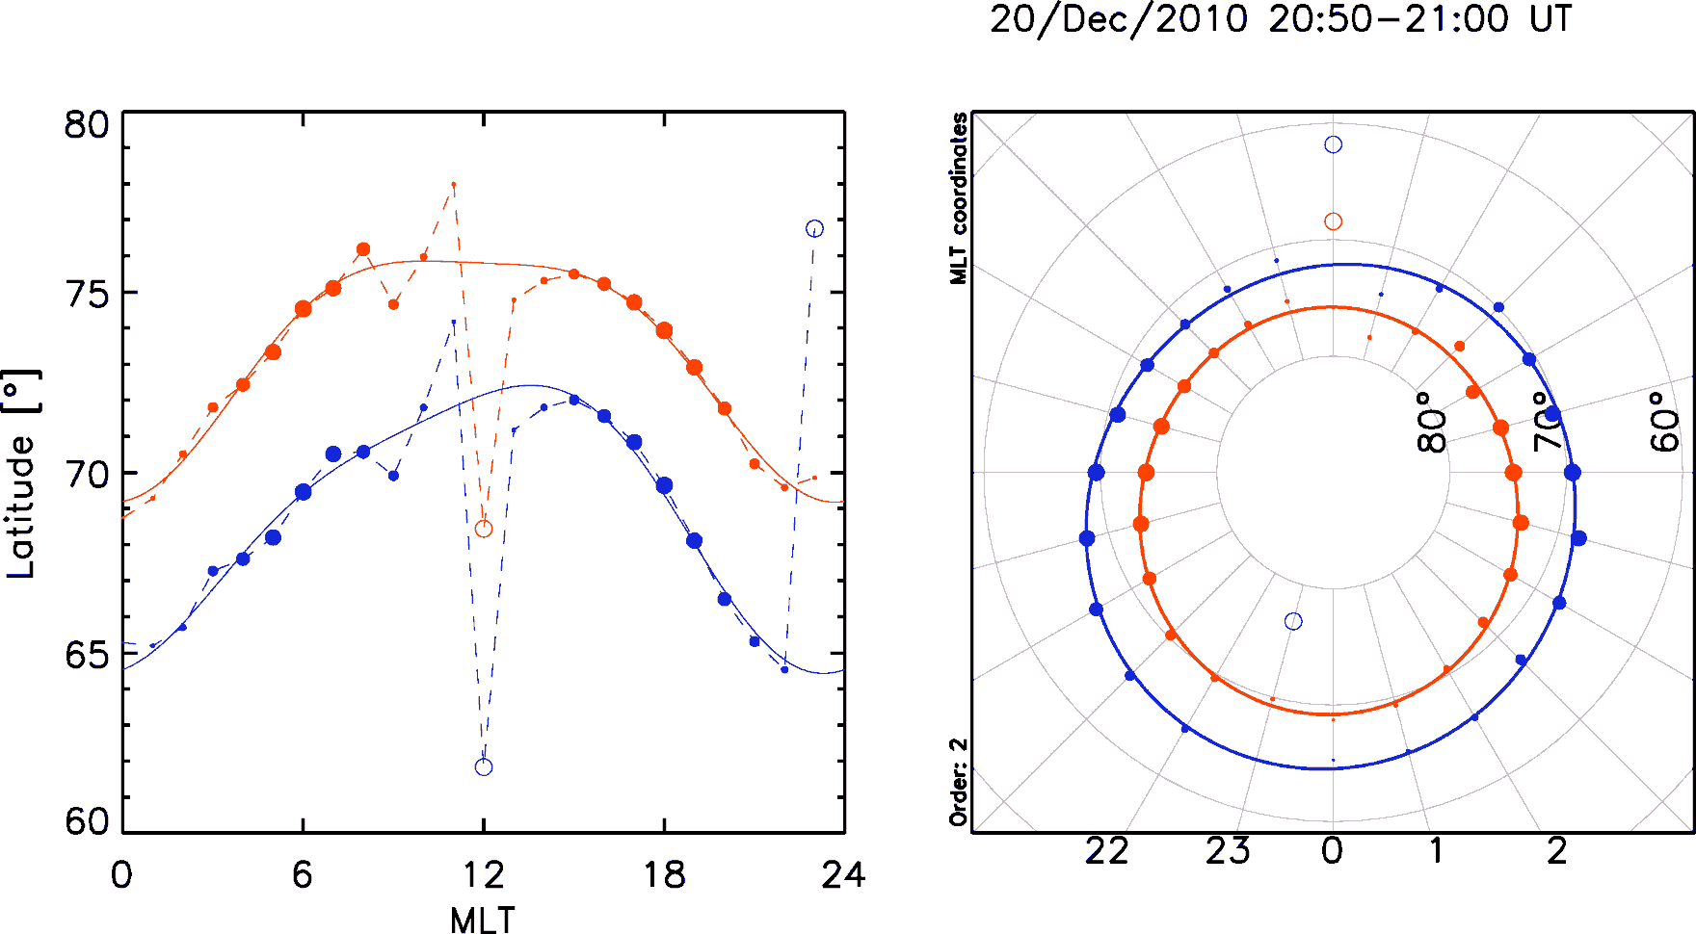
Observations
Locating FACs
Extract FAC intensity at each MLT
Fit a suitable function to each meridional profile
Combine locations from all meridional profiles to get a hemispheric FAC location
Lasse Clausen (Space@VT)
SuperDARN/AMPERE study
SD Workshop, June 2011

Slide 18
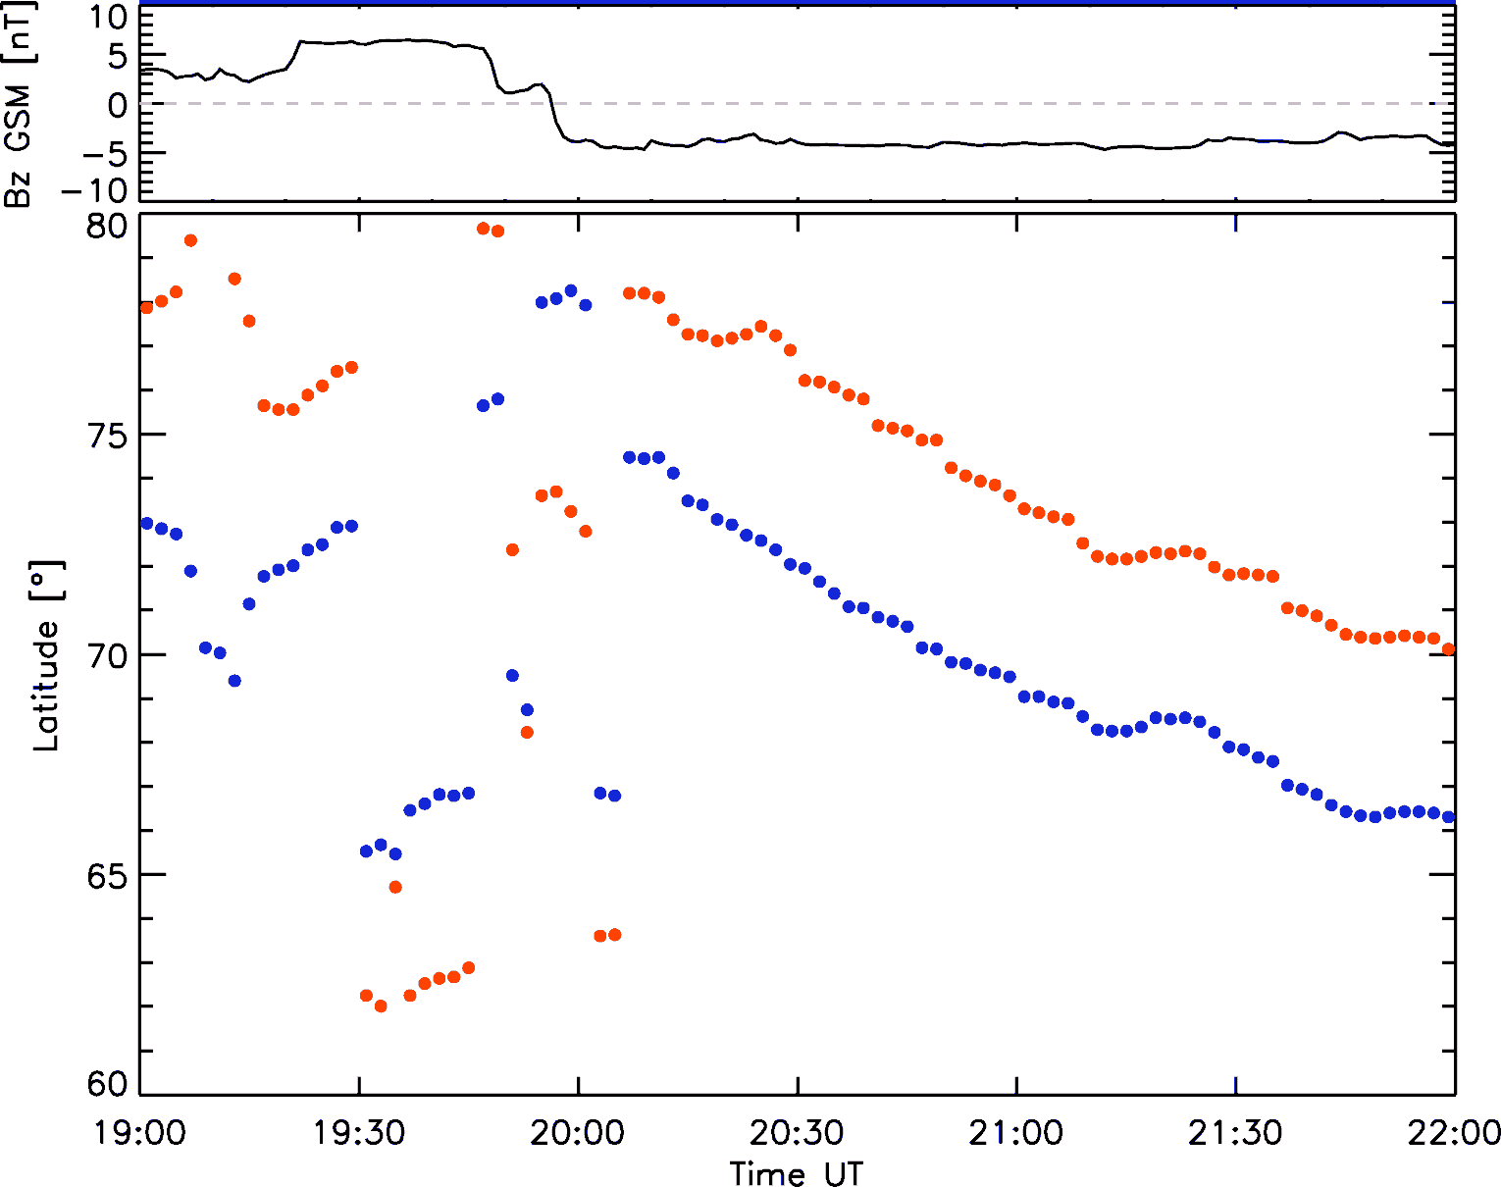
Observations
FAC in Motion
During northward IMF R1 & R2 currents are weak, so that the fitting fails
During southward IMF the currents intensify and fitting is more reliant
Due to magnetic flux being opened on the dayside, the polar cap expands and with it the FAC locations
Lasse Clausen (Space@VT)
SuperDARN/AMPERE study
SD Workshop, June 2011

Slide 19
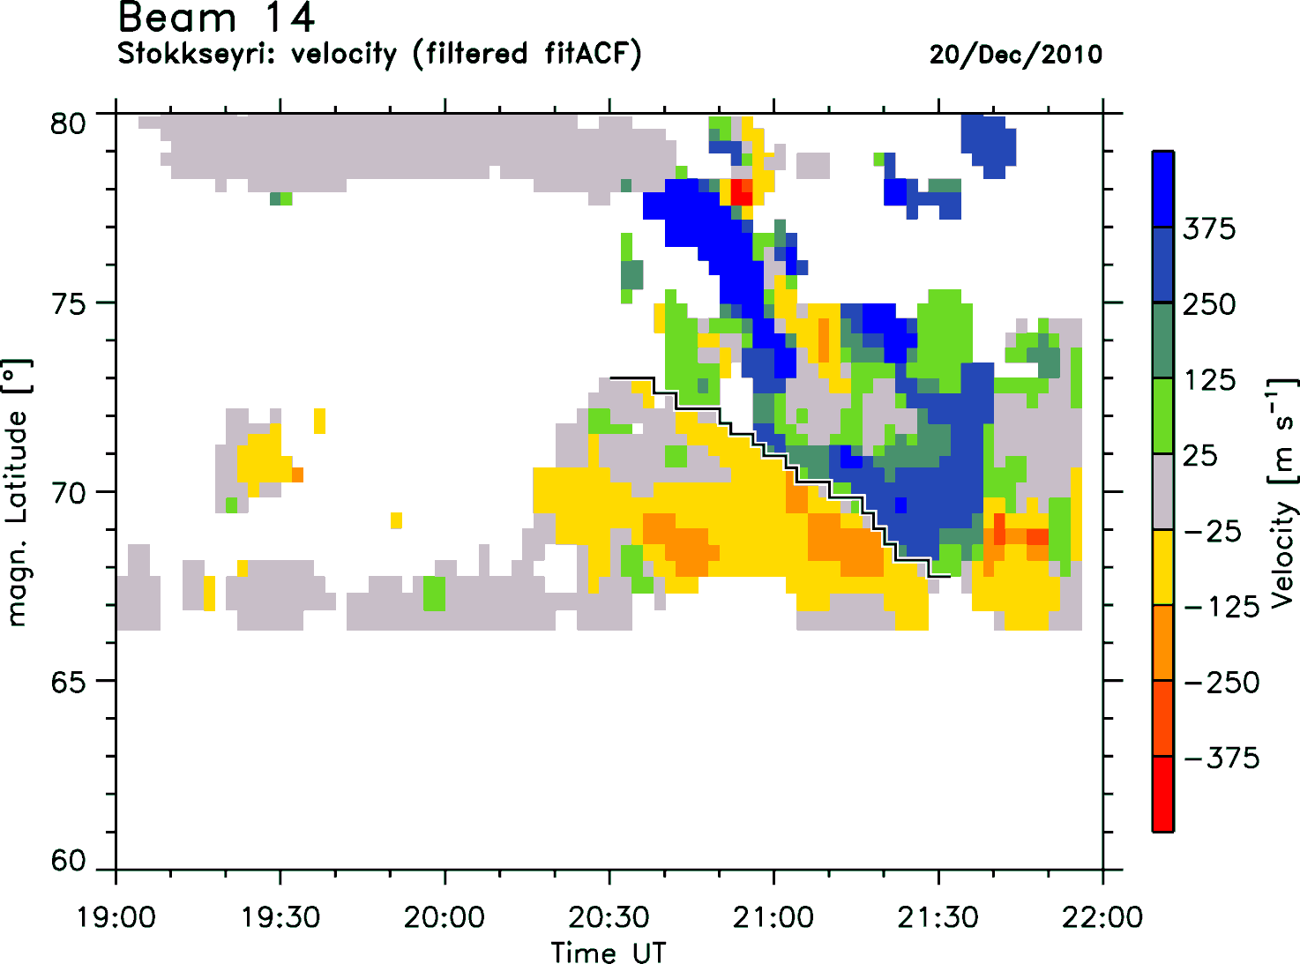
Observations
Velocity Shear
The radar at Stokkseyri observed strong velocity shears during the period of southward IMF
Lasse Clausen (Space@VT)
SuperDARN/AMPERE study
SD Workshop, June 2011

Slide 20
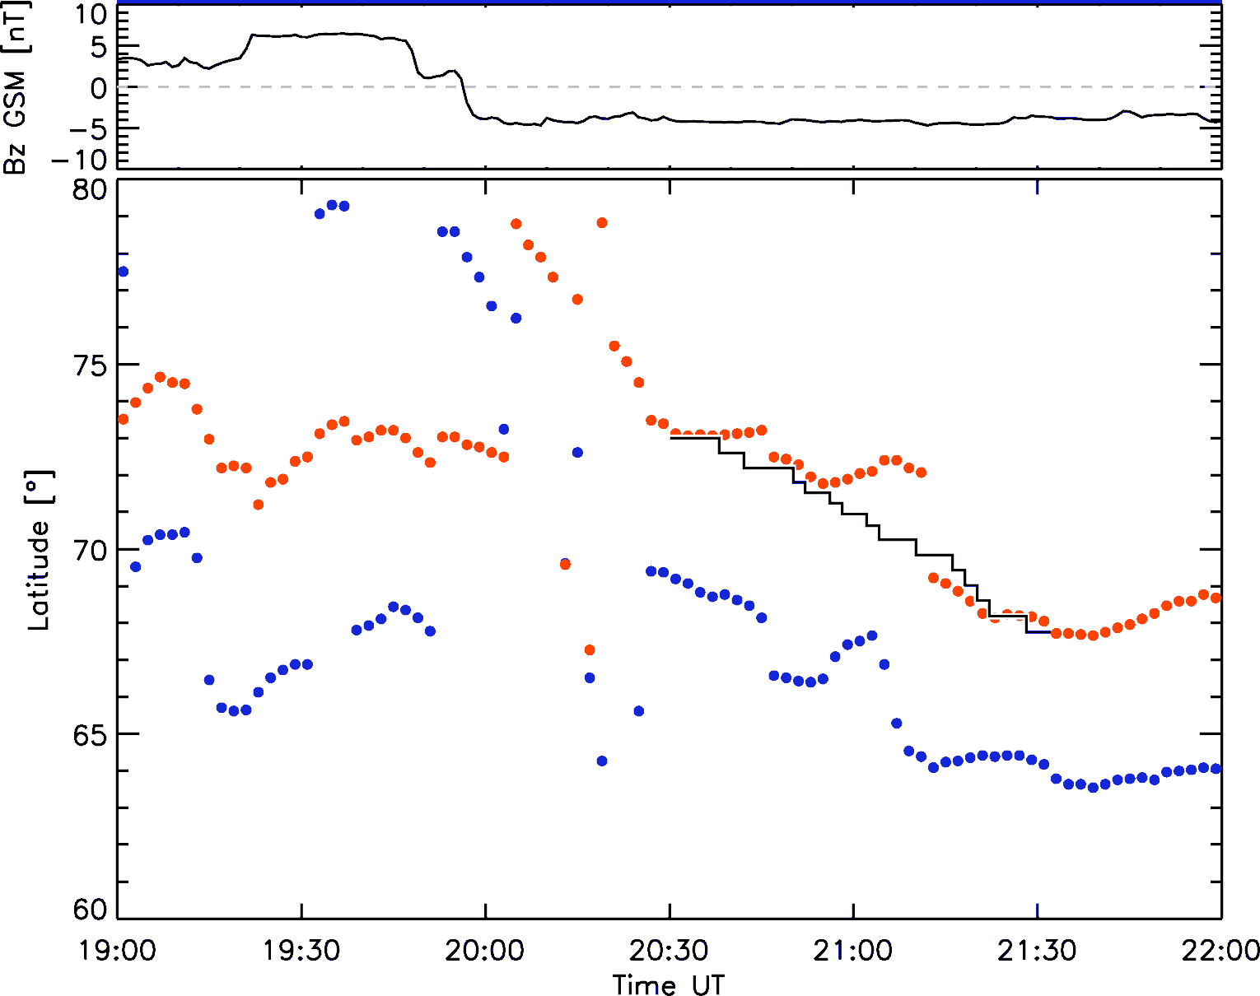
Observations
Velocity Shear vs. FAC Motion
The radar at Stokkseyri observed strong velocity shears during the period of southward IMF
These shears are co-located with the center of the FACs as observed by AMPERE
The motion of the velocity shear is very close to the motion of the currents
Lasse Clausen (Space@VT)
SuperDARN/AMPERE study
SD Workshop, June 2011

Slide 21
Conclusions
Conclusions
AMPERE provide high time resolution observations of the field-aligned currents
Dayside reconnection causes the polar cap to expand and the FACs move equatorward
Co-located with the strongest FACs strong velocity shears are observed
Lasse Clausen (Space@VT)
SuperDARN/AMPERE study
SD Workshop, June 2011

Slide 22
Section Name
Subsection name
Slide Title
Name (Space@VT)
Short Presentation Title
Meeting, Date

